Slide 1
Machine learning for spatiotemporal PM_{2.5} estimates across the western US, 2008-2014
Melissa May Maestas, PhD
Research Associate (Post-Doctoral)
CU Boulder, CIRES, Earth Lab
Colleen Reid, PhD
Ellen Considine, BS-candidate
Gina Li, MS-candidate

Slide 2
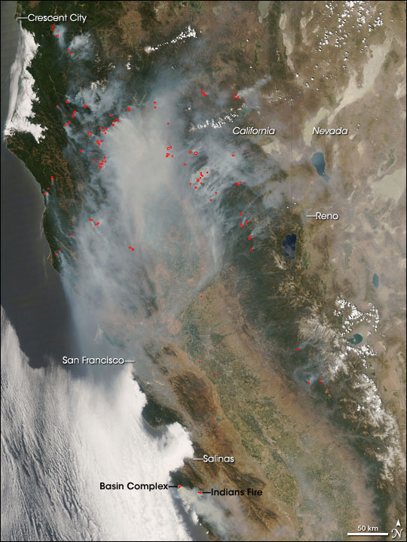
Why wildfires?
Globally and regionally, wildfire risk is projected to increase under various potential future climate scenarios.
The percent of our air pollution due to wildfires will likely increase, not just from climatic changes, but also because of declines in other sources of air pollution
http://earthobservatory.nasa.gov/IOTD/view.php?id=8865
Notes:
**put in an image of wildfires in Colorado and discuss ‘natural’ versus ‘unnatural’

Slide 3
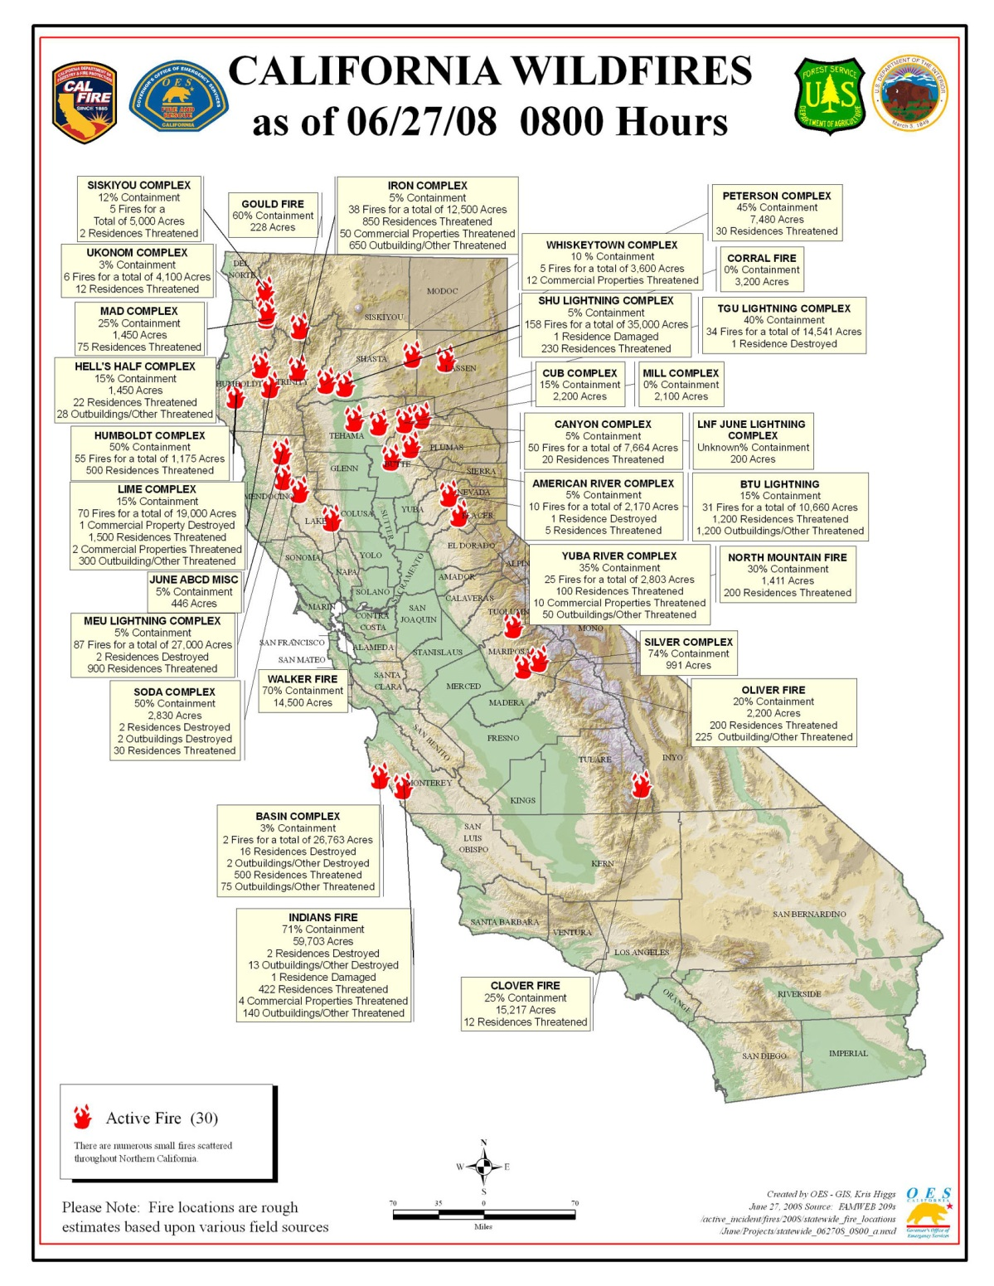
2008 northern California wildfires
Lightning storm on June 20-21, 2008
Over 6000 lightning strikes
Thousands of fires
Smoke covered large population areas for weeks (est. 10-12 million people exposed)
Potential for adverse health effects on large population
Notes:
I became interested in this when I was working for the EPA in San Francisco – there had just been an intense wildfire that had caused many people to call in to the air office complaining of the health impacts. But the air team had no idea if this was

Slide 4
What are the health effects from exposure to wildfire smoke?
Clear evidence of respiratory health effects
Particularly for exacerbation of asthma, COPD
Growing evidence of increased risk of all-cause mortality
Mixed findings for cardiovascular outcomes
A few studies have found associations with adverse birth outcomes
More research needed
→ more research needed for health outcomes not yet studied or understudied
→ to further evaluate cardiovascular outcomes
→ to better understand effects of duration and intensity of wildfire smoke exposures
→ to identify vulnerable subpopulations
Source: Reid et al. 2016. Critical review of health impacts of wildfire smoke exposure. Environmental Health Perspectives
Notes:
From a health perspective, there are impacts on the people living closest to the fire in terms of loss of life and psychological trauma from living through an extreme weather event, and from wildland firefighters in terms of their inhalation and physical exposures to fire, however, my talk today is concerned with the effects on the population living downwind and experiencing higher than average air pollution exposures. From a review of the literature on this, my colleagues and I found….

Slide 5
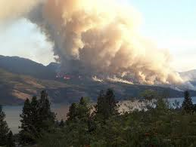
Exposure assessment difficulties
Sparse air pollutant monitoring network
Many PM_{2.5} monitors only measure every sixth or third day
Leads to spatial and temporal averaging of exposure measurements
But, smoke plumes migrate quickly, changing exposures over smaller spatial and temporal scales
Notes:
One of the things that came up in my own epidemiological investigations into the health effects of wildland fire smoke was exposure assessment difficulties.

Slide 6
Spatiotemporal exposure data sources
Aerosol optical depth (AOD) satellite data
Benefits – covers the whole land area and has temporal coverage of more than once a day
Drawbacks – full column aerosol loading not just where people breathe, just measures during daylight hours
Chemical transport models
Benefits – can extract pollution estimates at ground level and covers whole land area
Drawbacks – modeled rather than measured data, uncertainties in the inputs, particularly the emissions estimates from wildfires
Notes:
Could we combine monitoring data, AOD, and CTM data in a meaningful way?

Slide 7
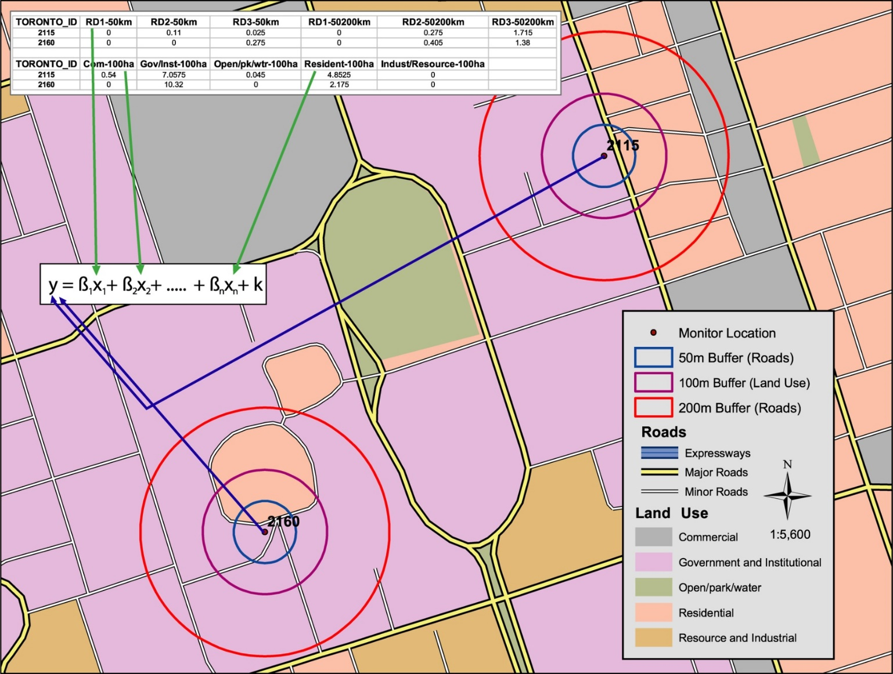
Methods – adapt land use regression modeling with machine learning
Include novel spatiotemporal datasets
Apply machine learning methods to
Select from a long list of predictor variables
Select from a variety of statistical algorithms
Image courtesy of Mike Jerrett
Notes:
I bring in the text box to say ways in which I adapted land use regression for this purpose – instead of long-term average, used spatiotemporal predictors to allow daily estimation and used machine learning to select between a lot of non-linear models

Slide 8
Variables | Data Source |  | Temporal Resolution | Spatial Resolution
Dependent Variable
PM_{2.5} from monitoring stations (N=121) | US EPA, California Air Resources Board, Air Districts, and US Forest Service |  | Daily or hourly
Spatiotemporal Variables
GASP AOD | National Oceanic and Atmospheric Administration |  | Half-hourly, daylight | 4 km
MODIS AOD | NASA |  | Twice daily | 10 km
Local AOD | Sonoma Technology, Inc. |  | Daily | 0.5 km
WRF-Chem PM_{2.5} (µg/m³) | National Center for Atmospheric Research |  | Hourly | 12 km
Distance to nearest cluster of active fires (m) Counts of fires in nearest cluster / distance | Derived from USDA Forest Service Remote Sensing Applications Center |  | Daily
Relative Humidity (%) Sea level pressure (Pa) Surface pressure (Pa) Planetary boundary layer height (m) U-component of wind speed (m/s) V-component of wind speed (m/s) Dew point temperature (K) Temperature at 2 m (K) | Rapid Update Cycle |  | Daily | 13 km
Spatial Variables
X-coordinate (m) Y-coordinate (m) | U.S. Environmental Protection Agency Air Quality System
Counts of traffic within 1 km | Dynamap 2000, TeleAtlas |  | Annual | 1 km
% of urban land use within 1km % of agricultural land use within 1km % of vegetation land use within 1km Any High intensity land use within 1km | 2006 National Land Cover Database |  |  | 1 km
Elevation (m) | National Elevation Dataset 2010
Binary indicator variables for air basin | California Air Resources Board |  |  | Air Basin
Population Density | U.S. Census 2000 |  |  | Block Group
Temporal Variables
Julian Date Weekend |  |  | Daily
Reid et al. 2015. Environmental Science & Technology
Notes:
We amassed a very large dataset to do this

Slide 9
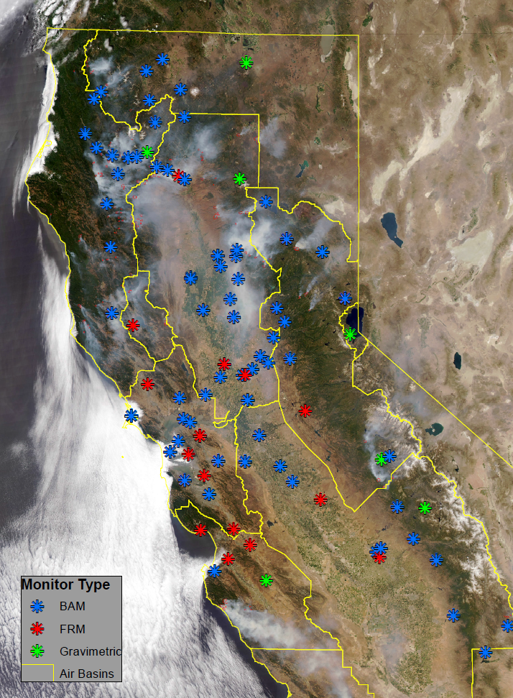
PM_{2.5} Monitoring Data
121 PM_{2.5} Monitors
EPA, CARB, USFS
38 FRM
16 other gravimetric
67 BAMs
Co-located FEM monitors agree with FRM (Pearson r values 0.94 – 1.00).

Slide 10
Statistical Algorithms
Random Forest
Tree bagging
Generalized Boosting Models (GBM)
Generalized Linear Models (GLM)
GLM with penalized maximum likelihood (glmnet)
Multivariate adaptive regression splines (Earth)
Lasso regression
Ridge regression
Support Vector Machines
Gaussian Processes
Generalized Additive Models (GAM)
K nearest neighbors regression
Reid et al. 2015. Environmental Science & Technology

Slide 11
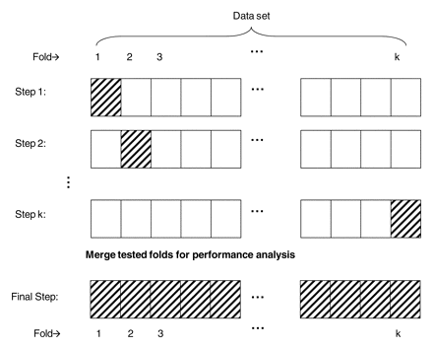
Statistical Methods – Machine Learning
29 predictor variables
121 monitoring locations
11 statistical algorithms
10-fold cross validation within each algorithm
To choose the covariates
To choose the tuning parameters of the algorithm
Minimize the CV-RMSE
Caret package in R
Functions rfe and train

Slide 12
Source: Reid et al. 2015. Spatiotemporal Prediction of Fine Particulate Matter During the 2008 Northern California Wildfires Using Machine Learning. Environmental Science & Technology.

Slide 13
Predictions for the top two models agreed with visible imagery
Source: Reid et al. 2015. Spatiotemporal Prediction of Fine Particulate Matter During the 2008 Northern California Wildfires Using Machine Learning. Environmental Science & Technology.
Notes:
With noted discrepancies due to the one time point of the visible imagery and the model was for a 24-hour average, and also the discrepancy of visible could have more smoke aloft whereas the model was trained to best estimate exposures at ground-level.

Slide 14
Variable Importance
Average Variable Importance
GASP AOD | 1088.40
distance to the nearest fire cluster | 327.99
WRF-Chem | 266.49
Julian date | 263.31
Surface pressure | 201.03
Local AOD | 195.17
sea level pressure | 182.81
Relative humidity | 175.75
V component of wind speed | 157.06
U component of wind speed | 135.87
X-coordinate | 134.86
MODIS AOD | 130.63
temperature at 2 meters | 116.02
Y-coordinate | 122.27
dew point temperature | 96.16
fire counts in nearest cluster / distance | 95.87
elevation | 75.52
planetary boundary layer height | 84.49
% urban land use within 1 km | 72.40
sum of traffic counts within 1 km | 71.98
% vegetated land use within 1 km | 37.64
Reid et al. 2015. Environmental Science & Technology

Slide 15
Reid et al. 2015. Environmental Science & Technology
Notes:
We also ran the model with fewer inputs and it could still do well – this speaks to the role of these learners that they can handle redundancies in the data (should not be used for inference but great at prediction).

Slide 16
Conclusions – Exposure Assessment
Combining multiple spatiotemporal datasets including satellite data and/or chemical transport model data could predict ground-level PM_{2.5} well during a wildfire
Tree-based algorithms predicted ground-level PM_{2.5} better than linear or other commonly used statistical models (e.g. GAM)
Data that could apply to any fire, “universal” variables, could predict ground-level PM_{2.5} almost as well as the full model

